Slide 2
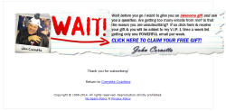
Home Business Tools Funnel
AR Series
AR Series
AR Series
prospect
Wp videos
NAMS8
Wp Plugins
Traffic
Squeeze Page email / to get report
OTO 1 / WP videos
OTO 2 / NAMS8 Resell
OTO 3 / WP Plugins Bundle
$17
$47
$97
AR / Confirmation
PLR Docs / bonus
DS2 / Video PLR
DS3 / Social Media Bundle
AR / welcome
$1
$17
$37

Slide 3
Home Business Tools Funnel
AR Series
prospect
Wp videos
Traffic
Squeeze Page email / to get report
OTO 1 / WP videos
$17
AR / Confirmation
PLR Docs / bonus
AR / welcome
$1

Slide 4
Home Business Tools Funnel
prospect
Traffic
Squeeze Page email / to get report
AR / Confirmation
AR / welcome

